Slide 1

To build a modular retro arcade…

Slide 2
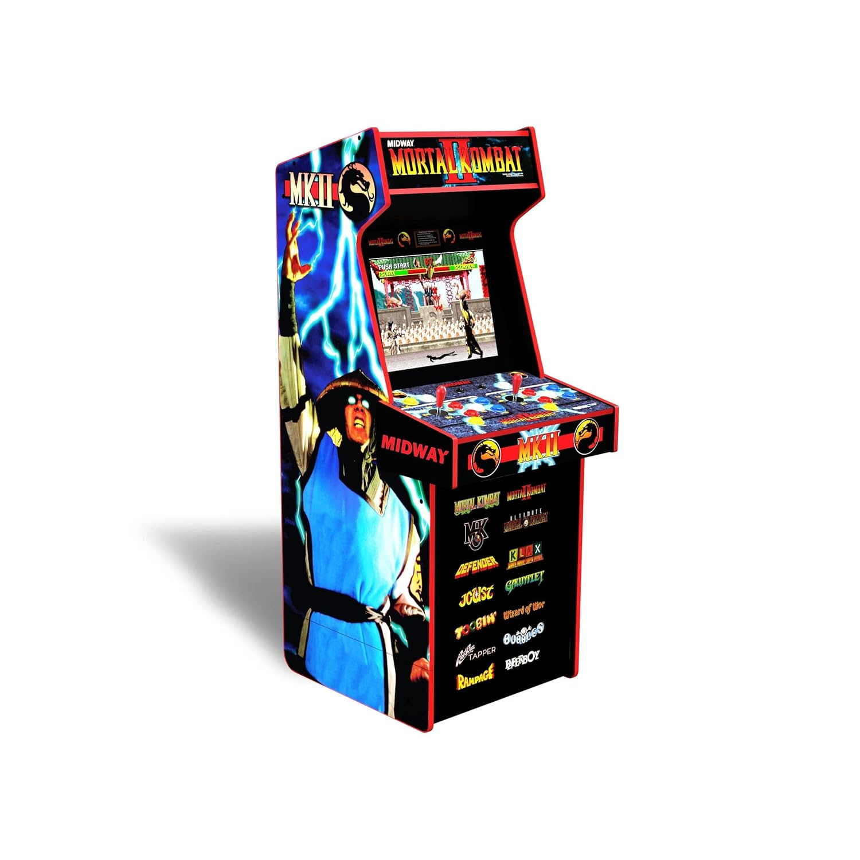
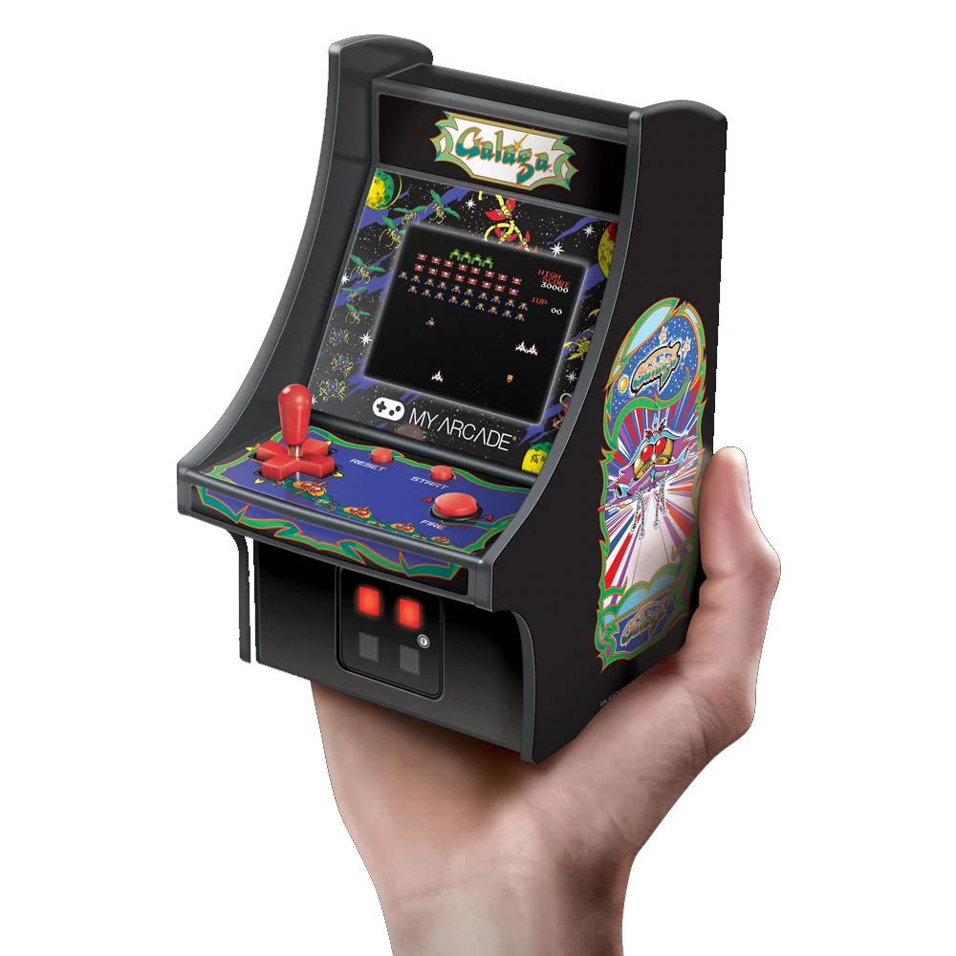
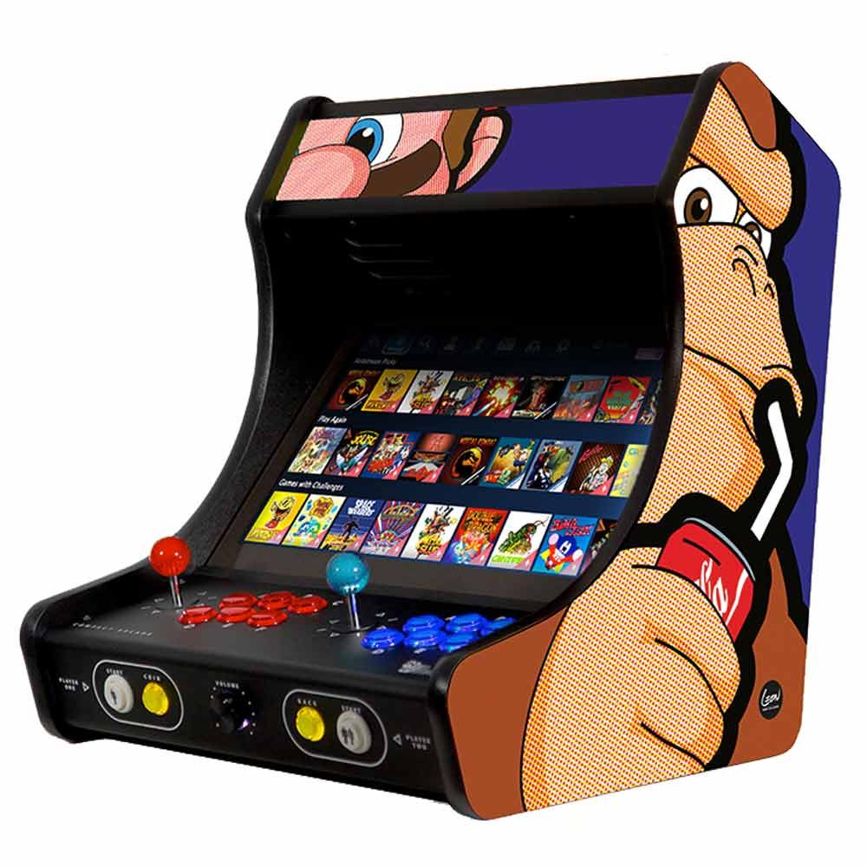

Slide 3
Part 1: Hardware

Slide 4

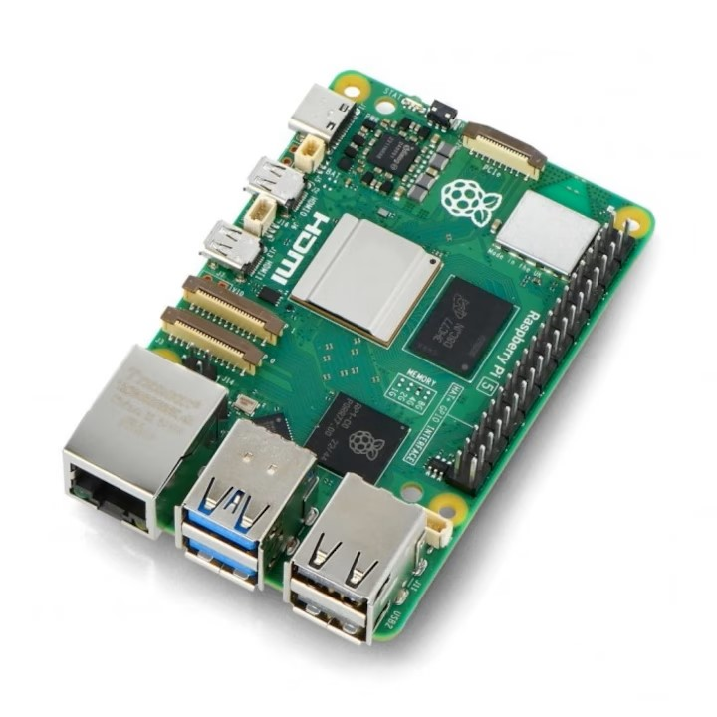
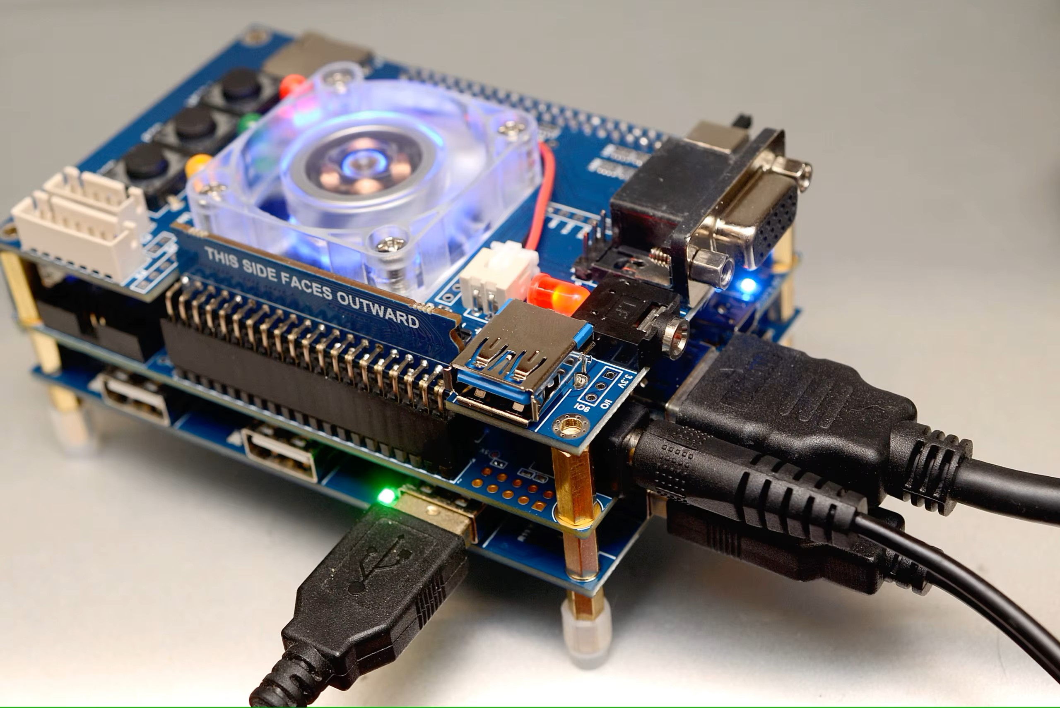





FPGA
Emulation
Notes:
MiSTer – 500$
MiSTer Pi – 180$
Pi 5 – 100$
SCART Hat – 10 – 20$

Slide 5
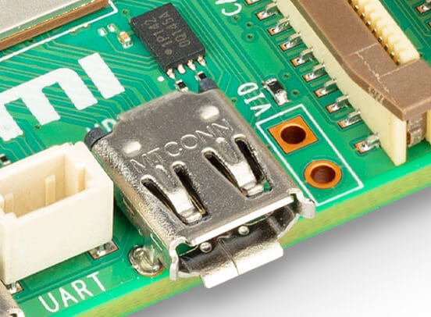
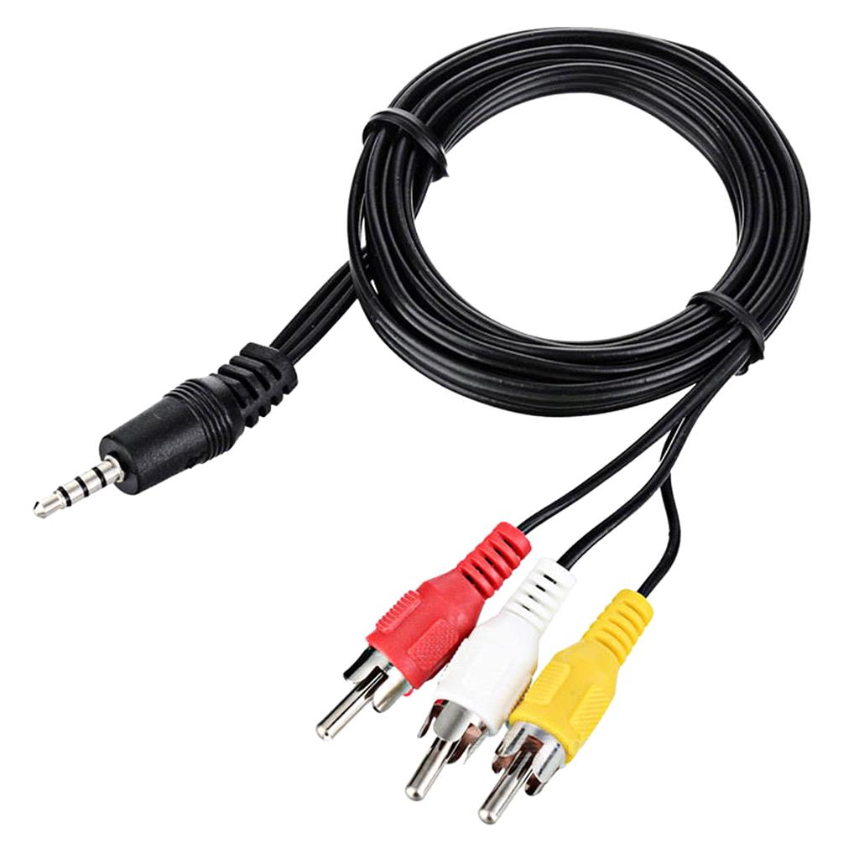
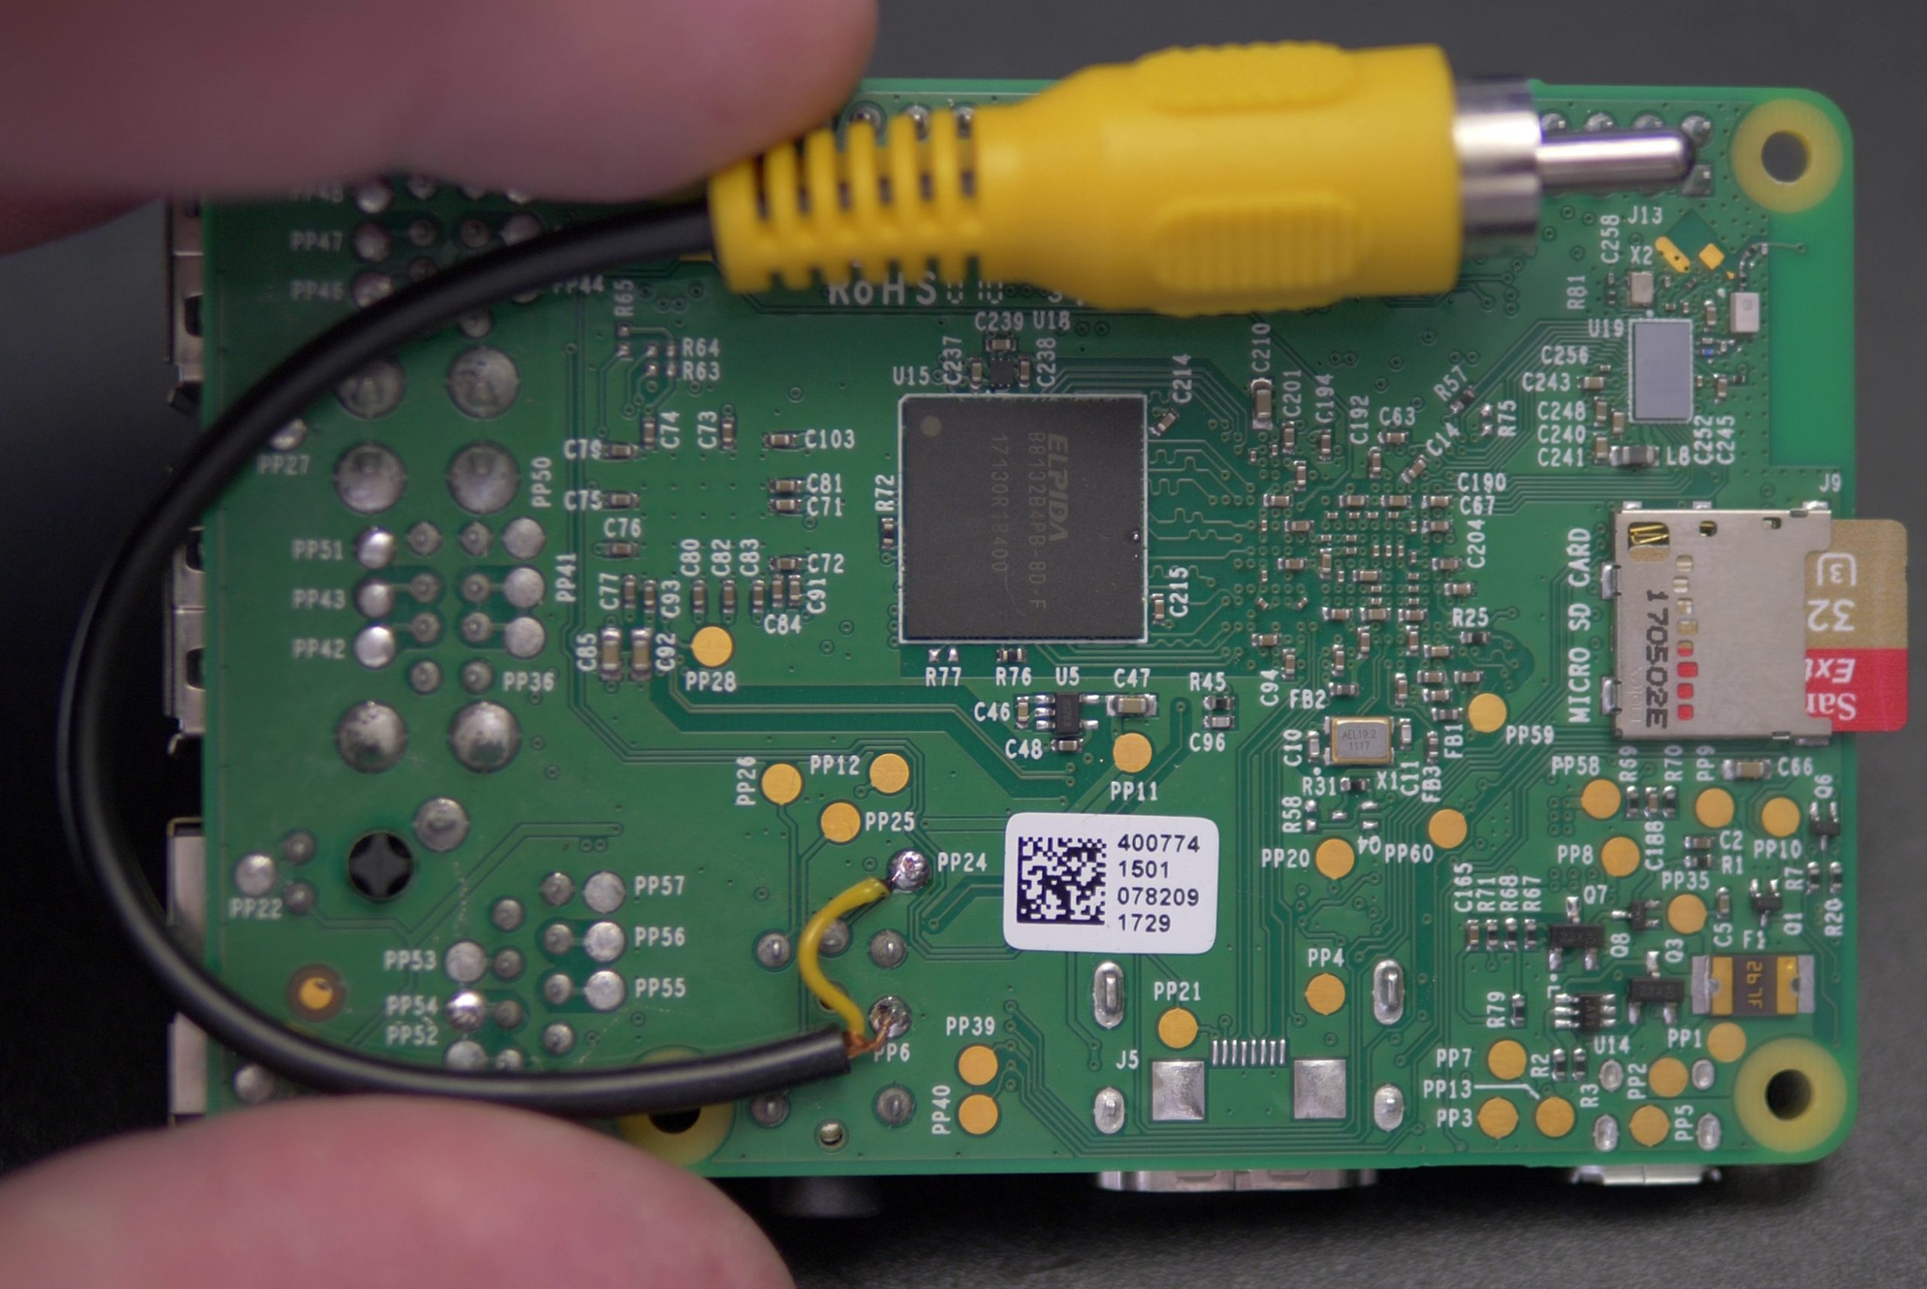
Display Connectivity - AV
Notes:
Composite Video

Slide 6
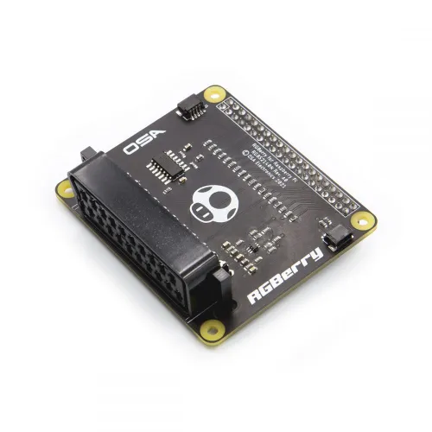
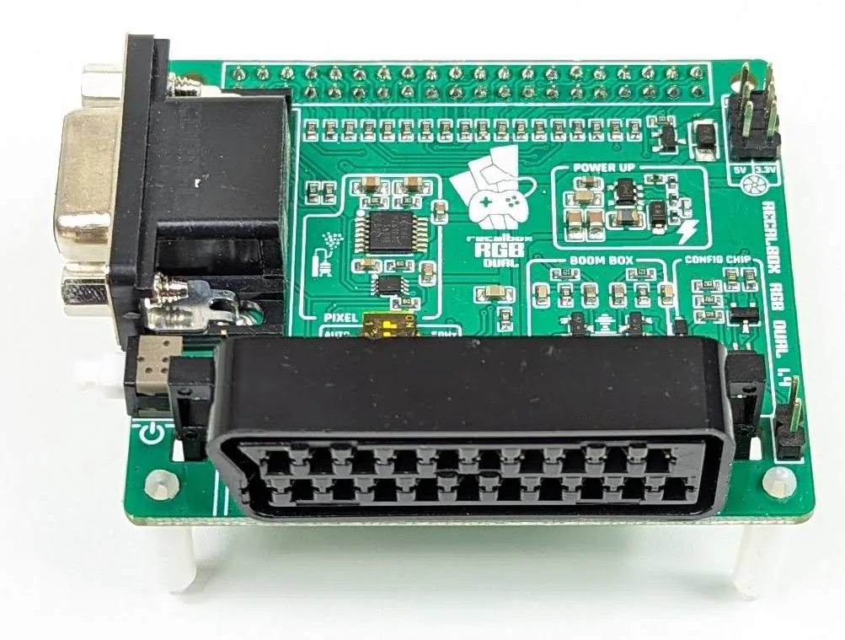
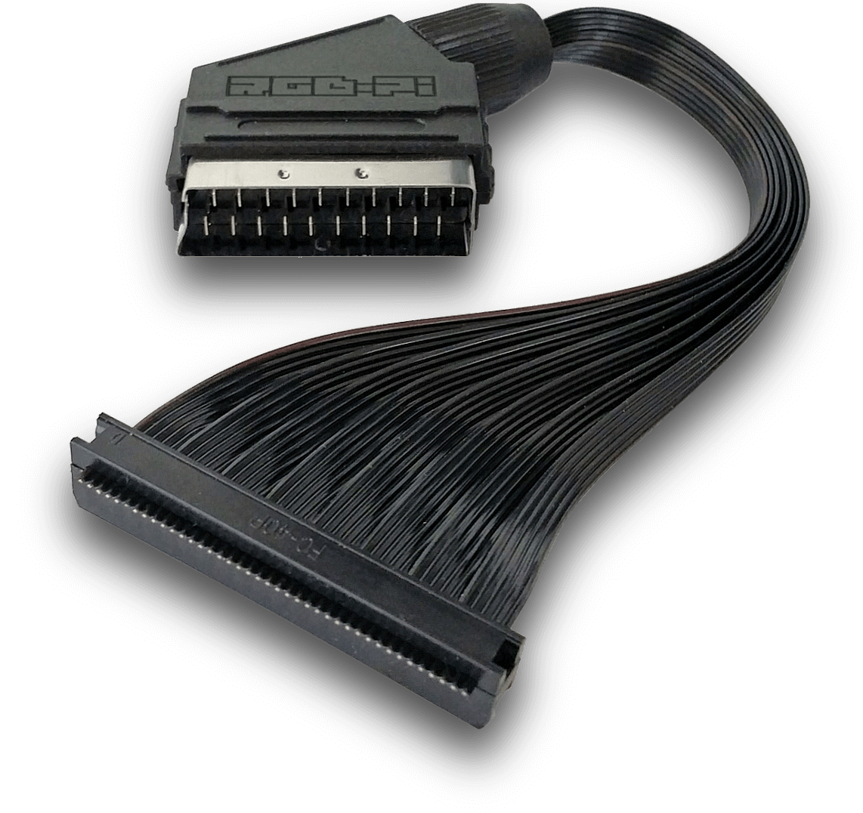
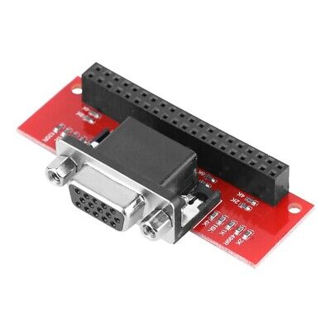
Display Connectivity – SCART HAT

Slide 7
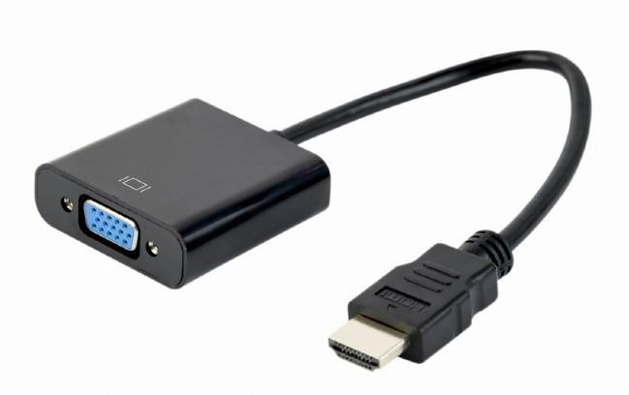
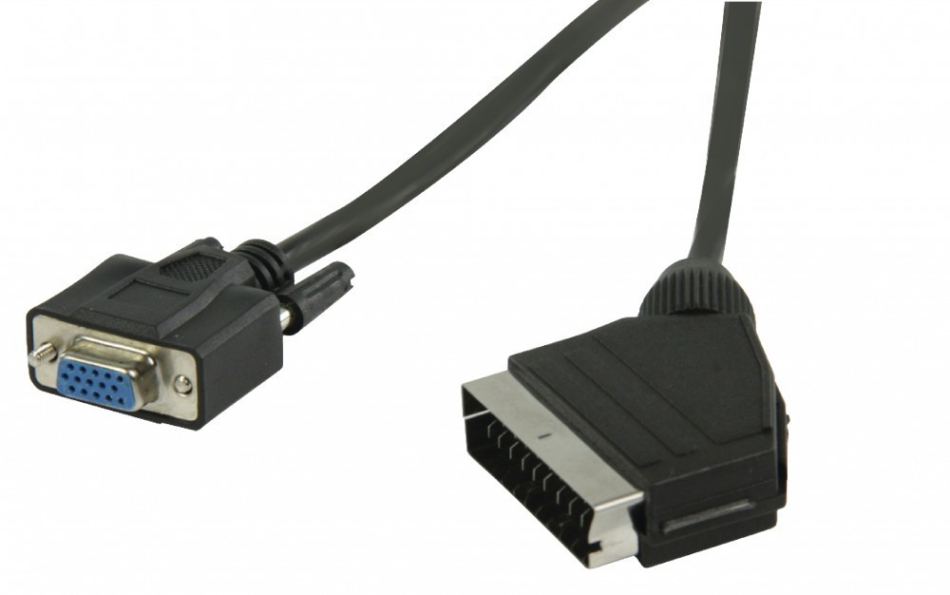


HDMI2VGA

Slide 8
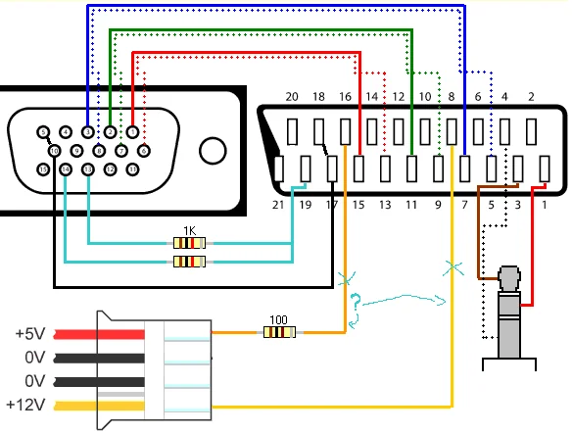
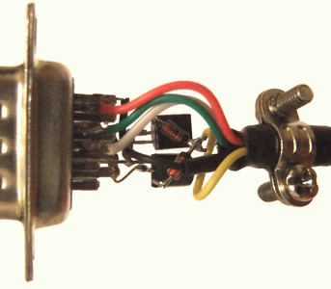
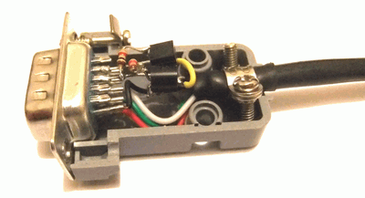
VGA2SCART

Slide 9
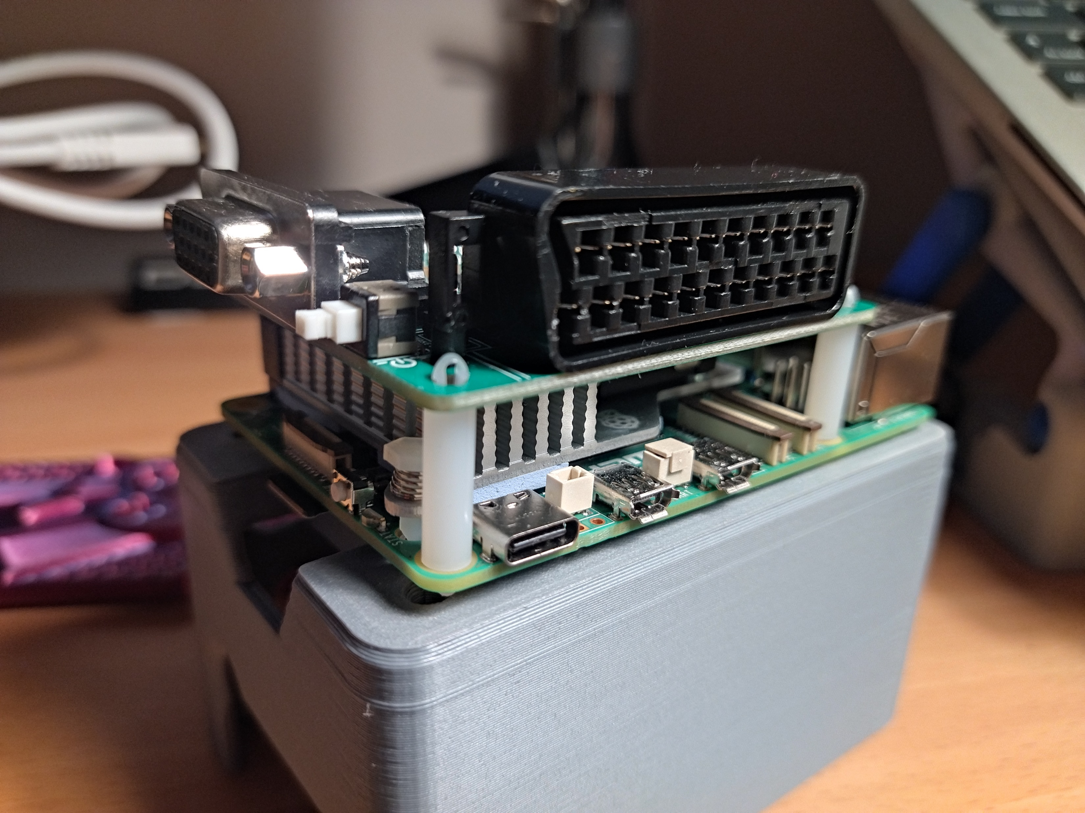
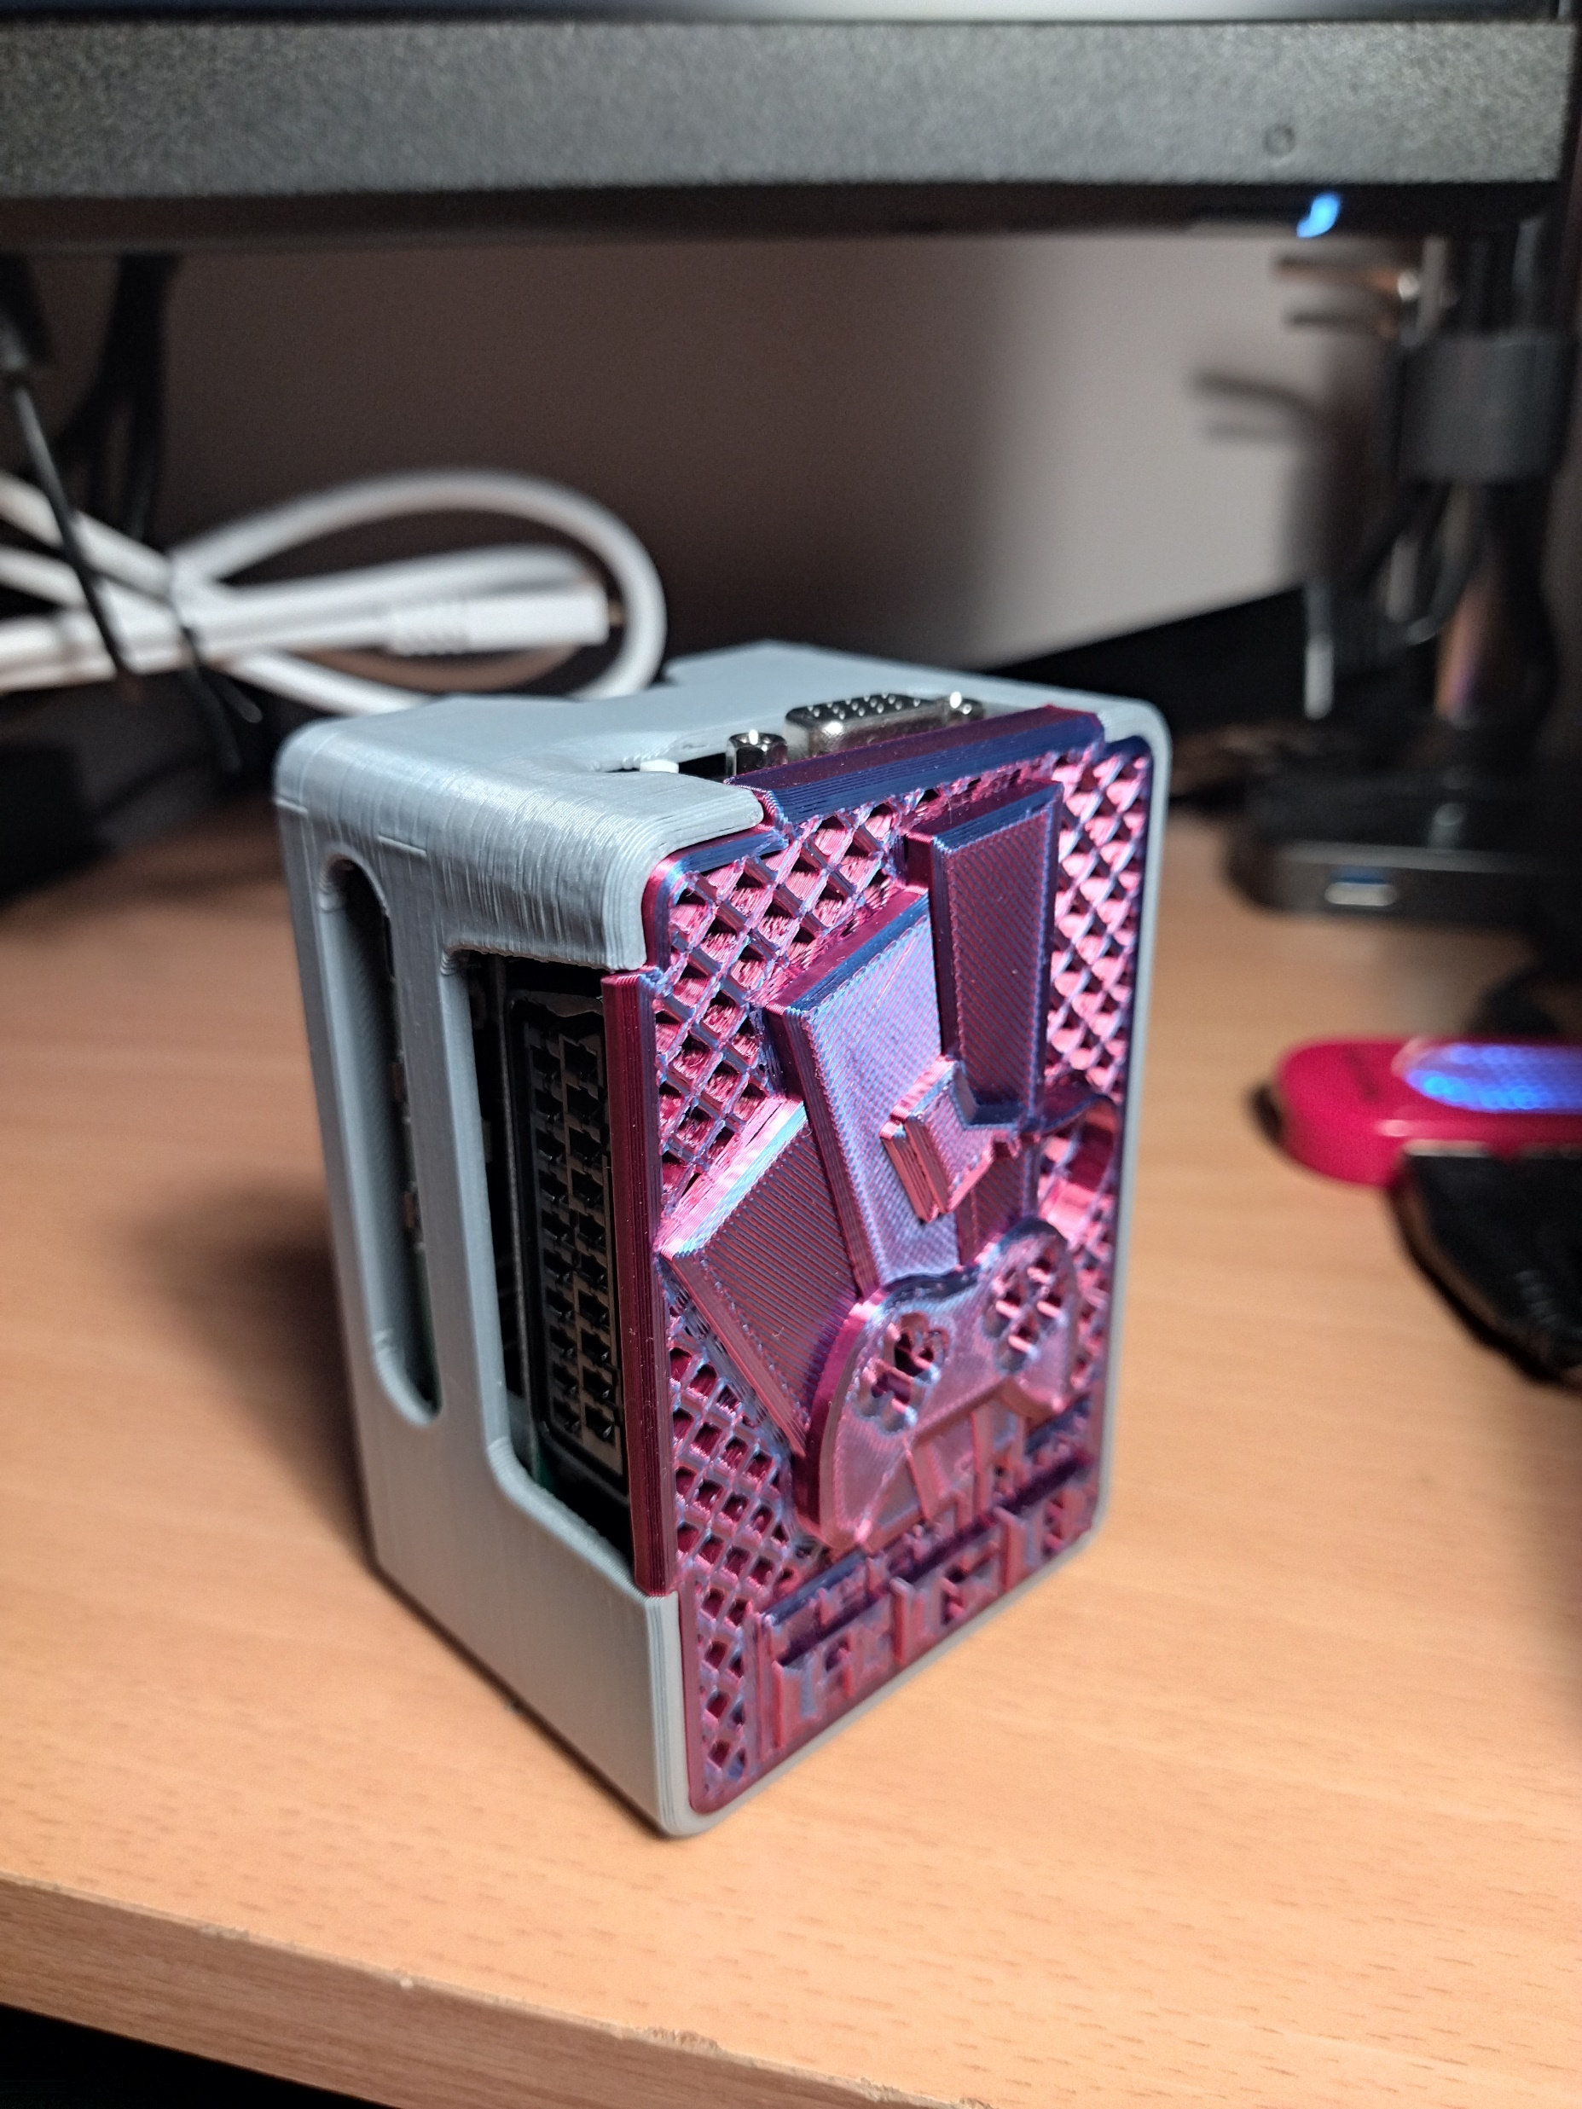

Slide 10
Part 2: Input

Slide 11
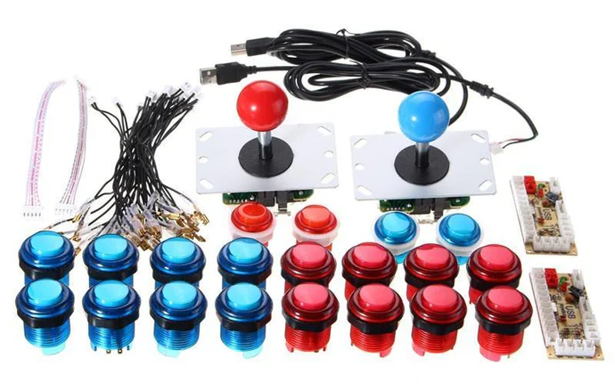

Slide 12
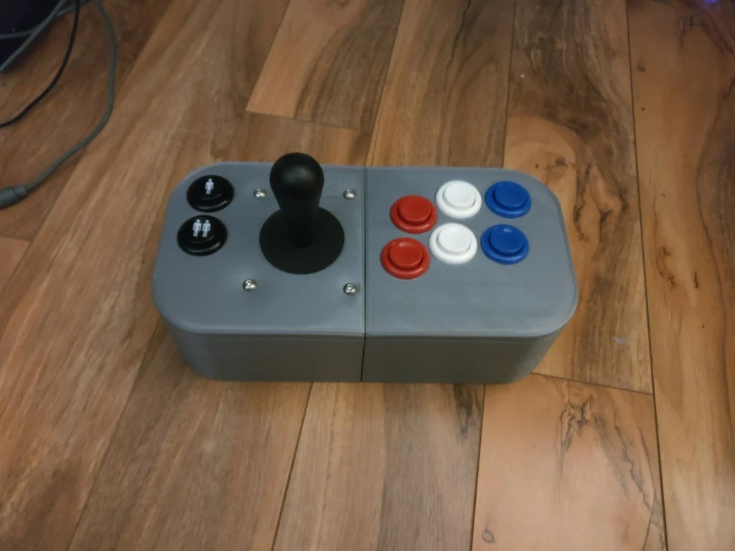
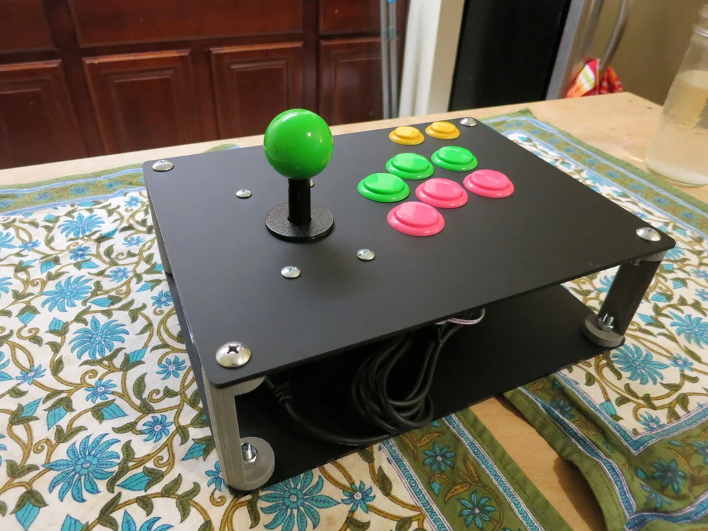
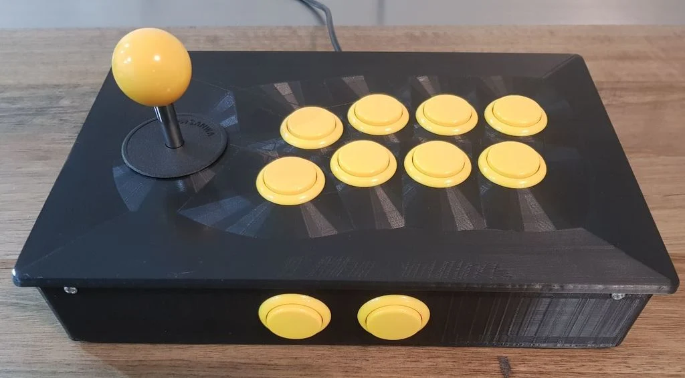
3D Printed Case

Slide 13
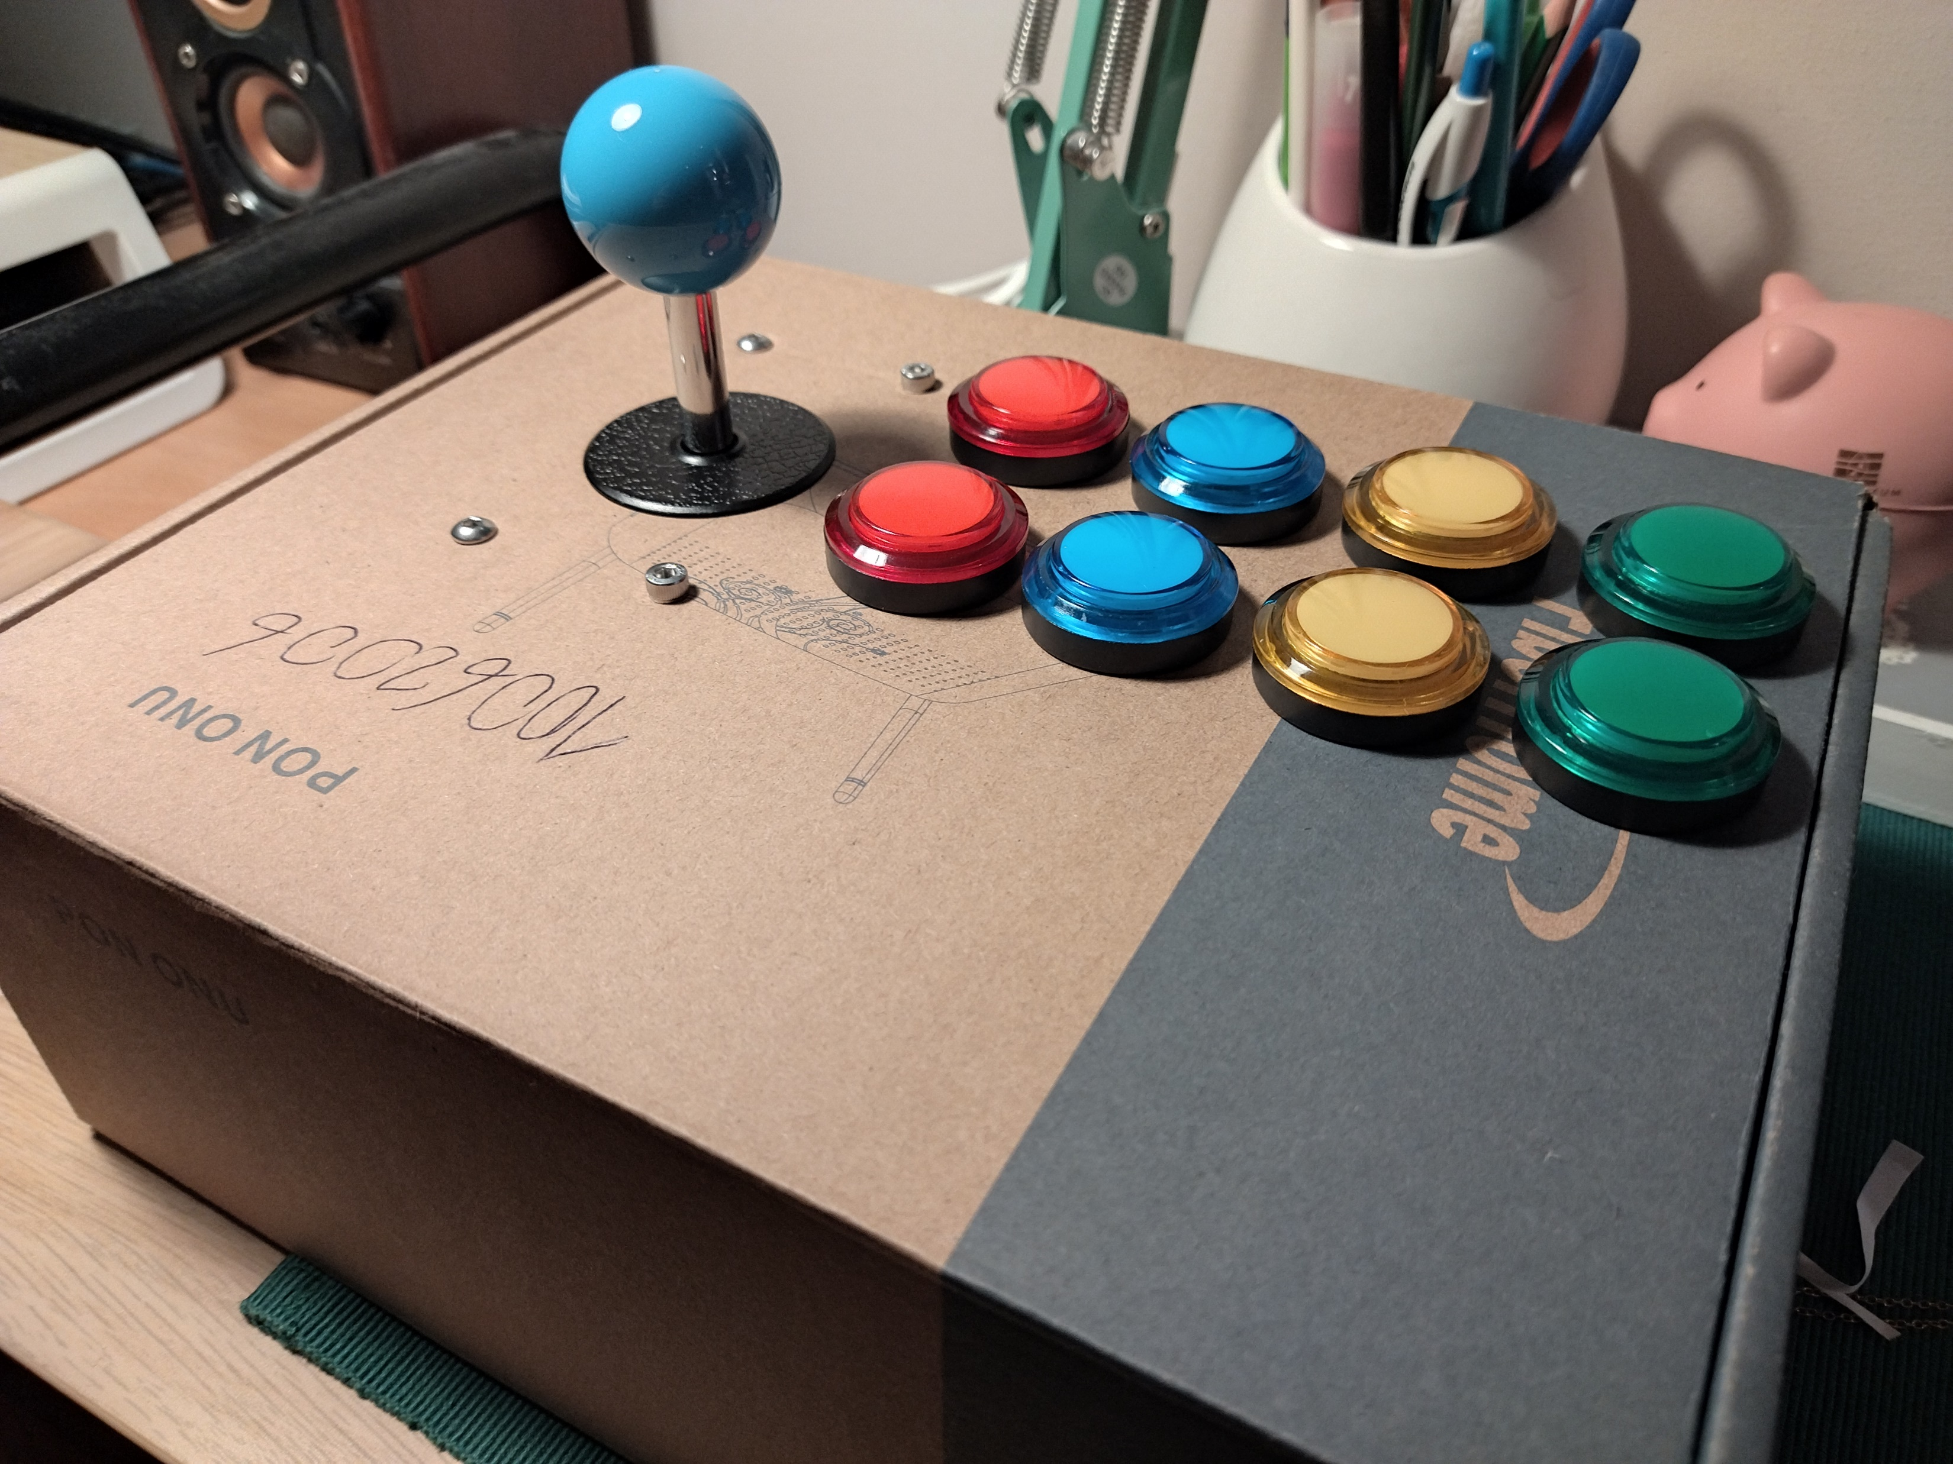
Shoebox

Slide 14
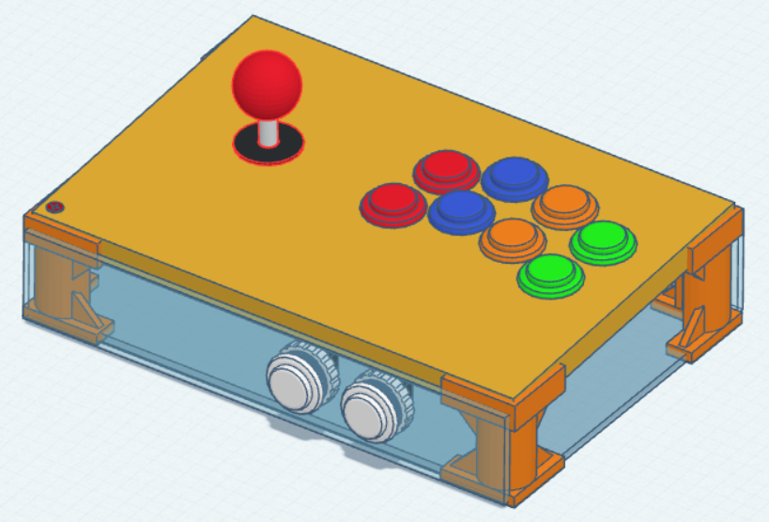
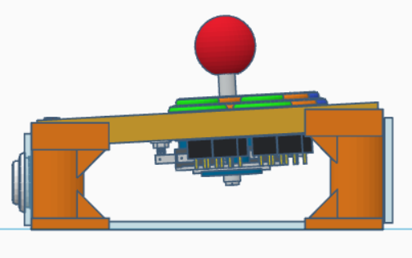
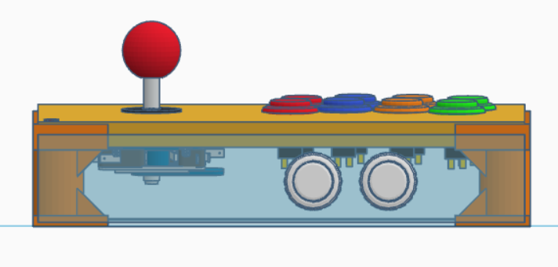

Slide 15
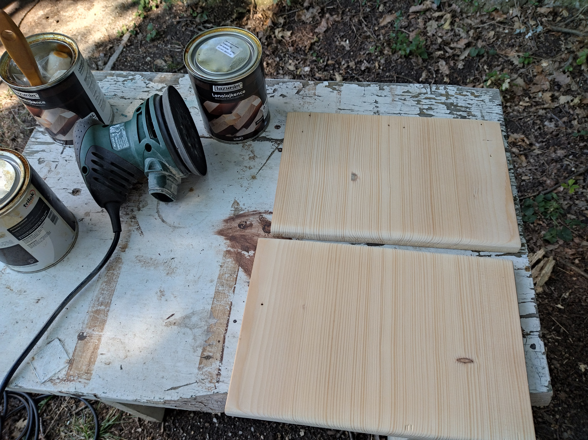
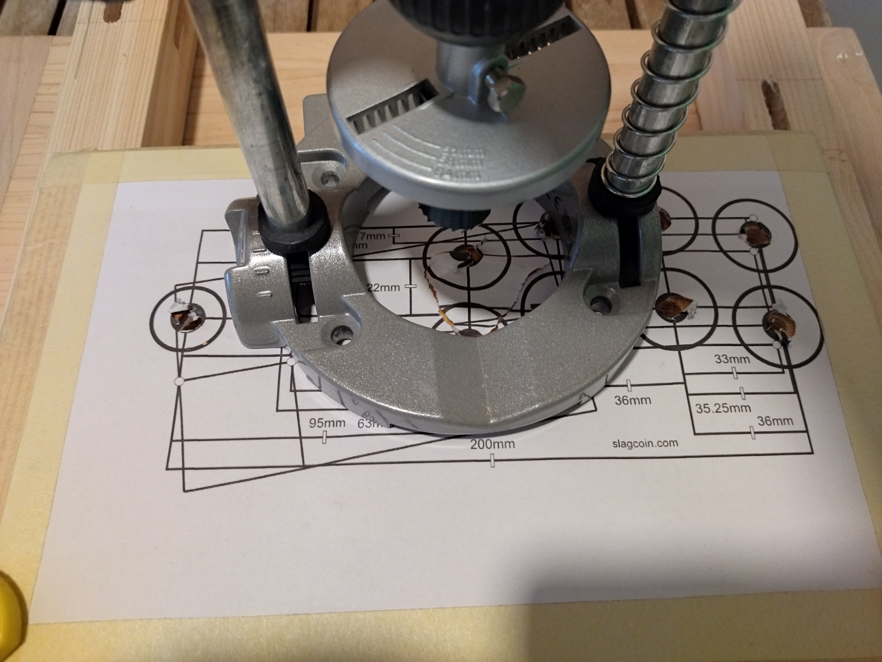
Notes:
linseed oil

Slide 16
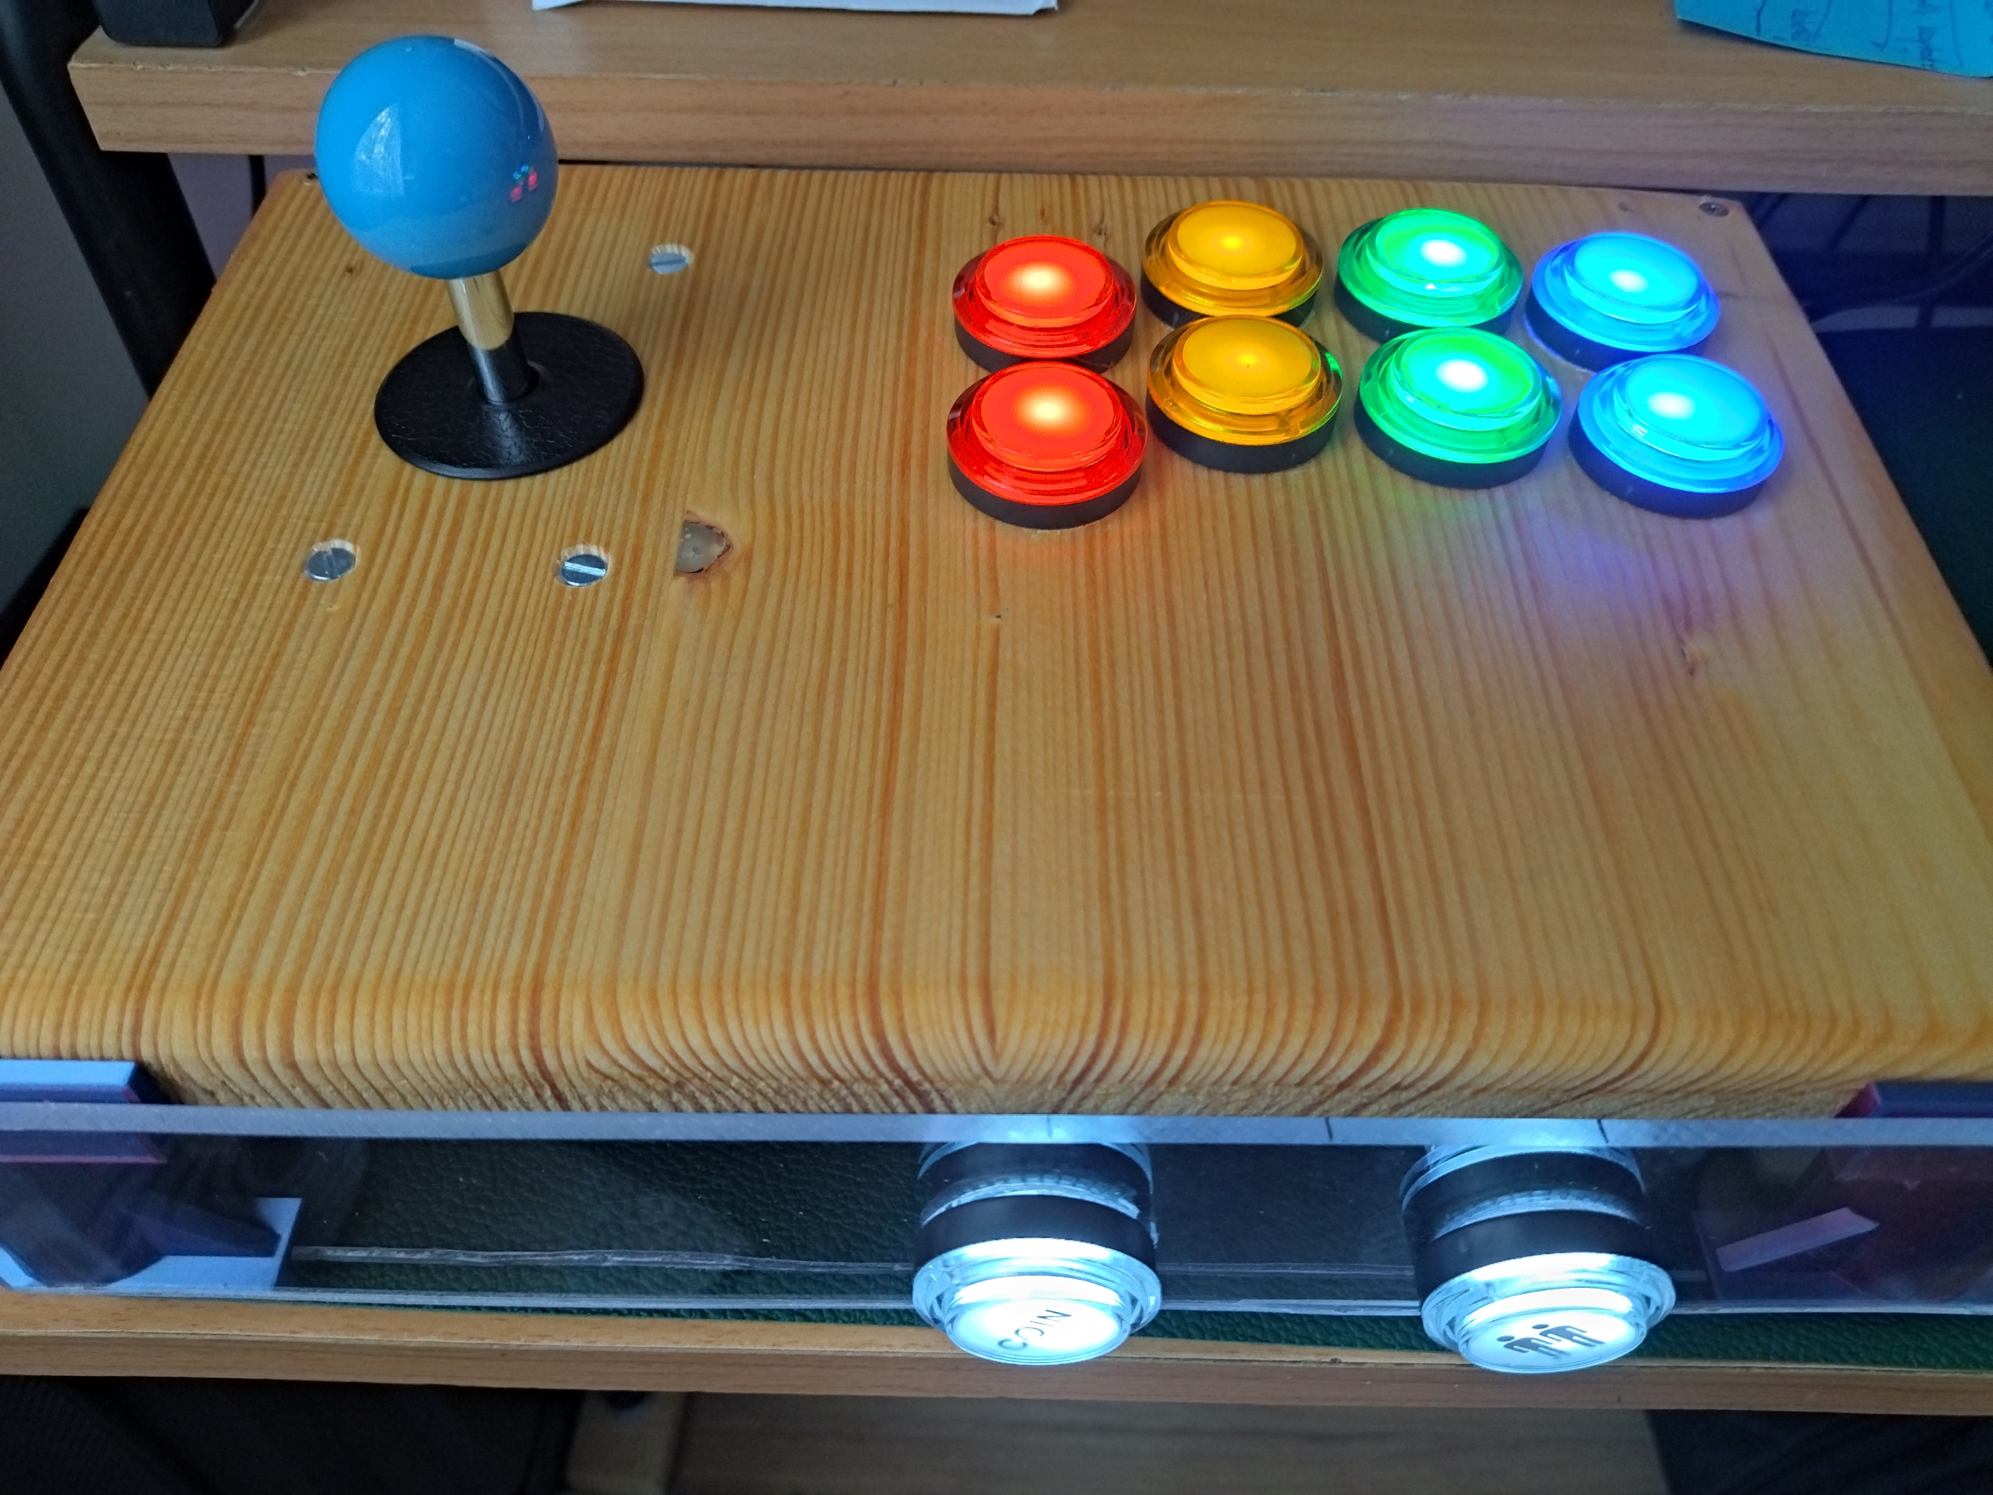

Slide 17
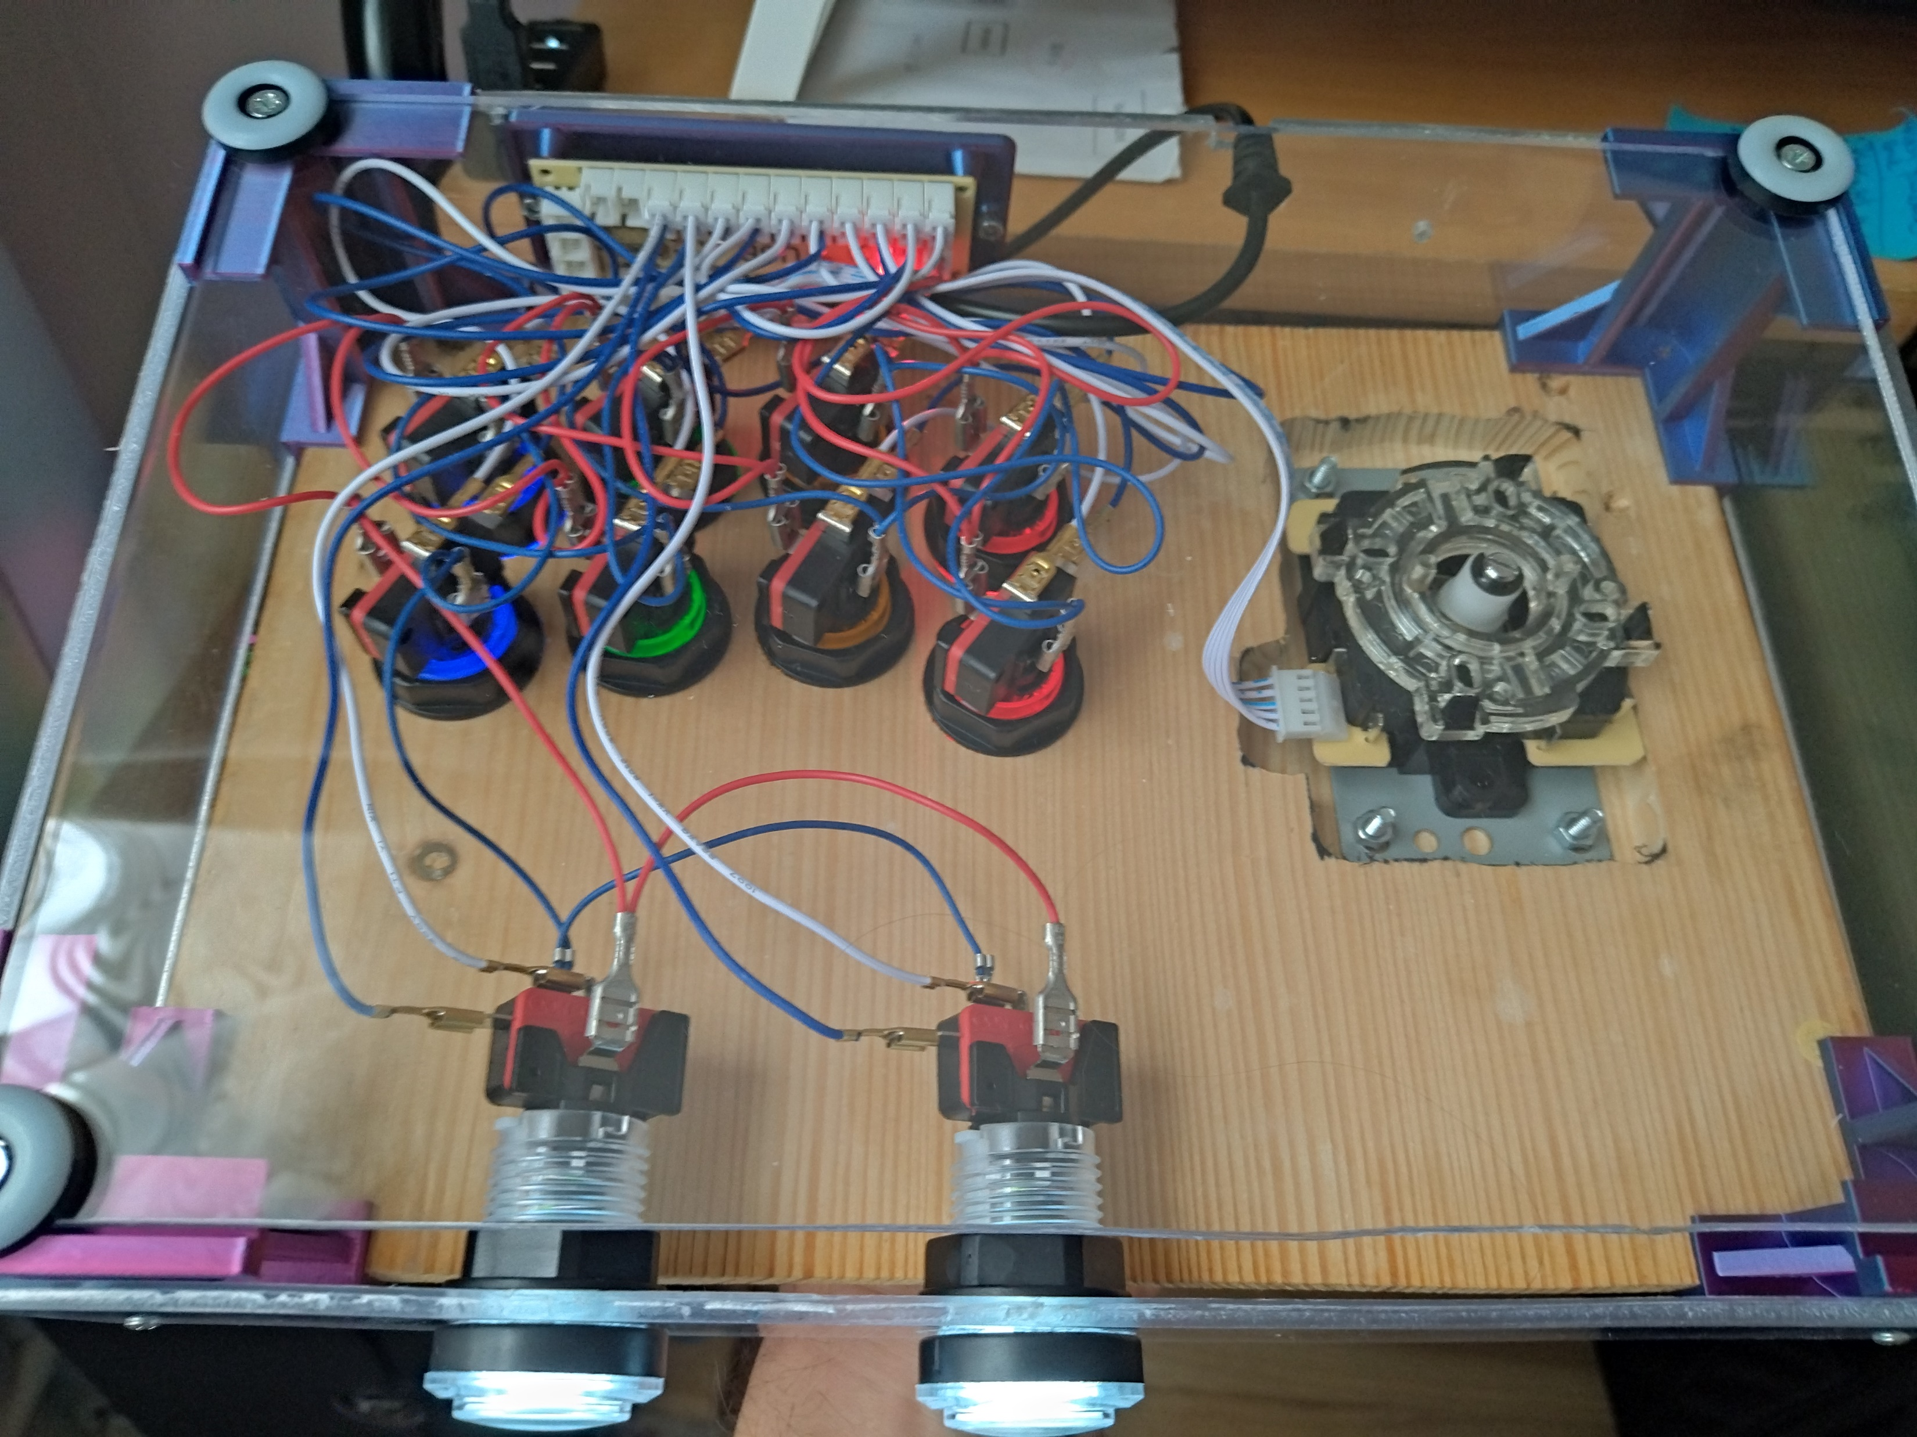

Slide 18
Part 3 – Display

Slide 19
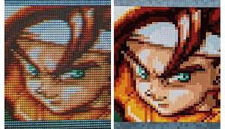
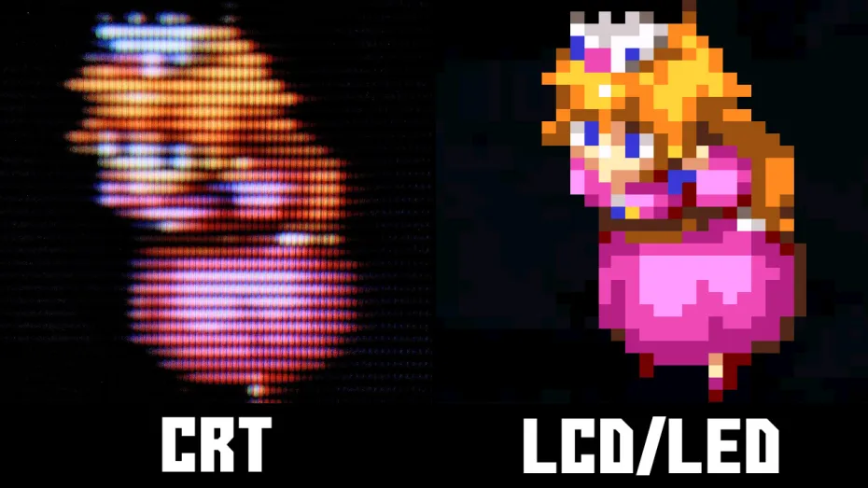
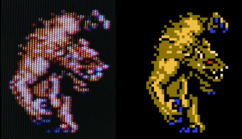

CRT VS LCD

Slide 20

Emulation - Shaders

Slide 21
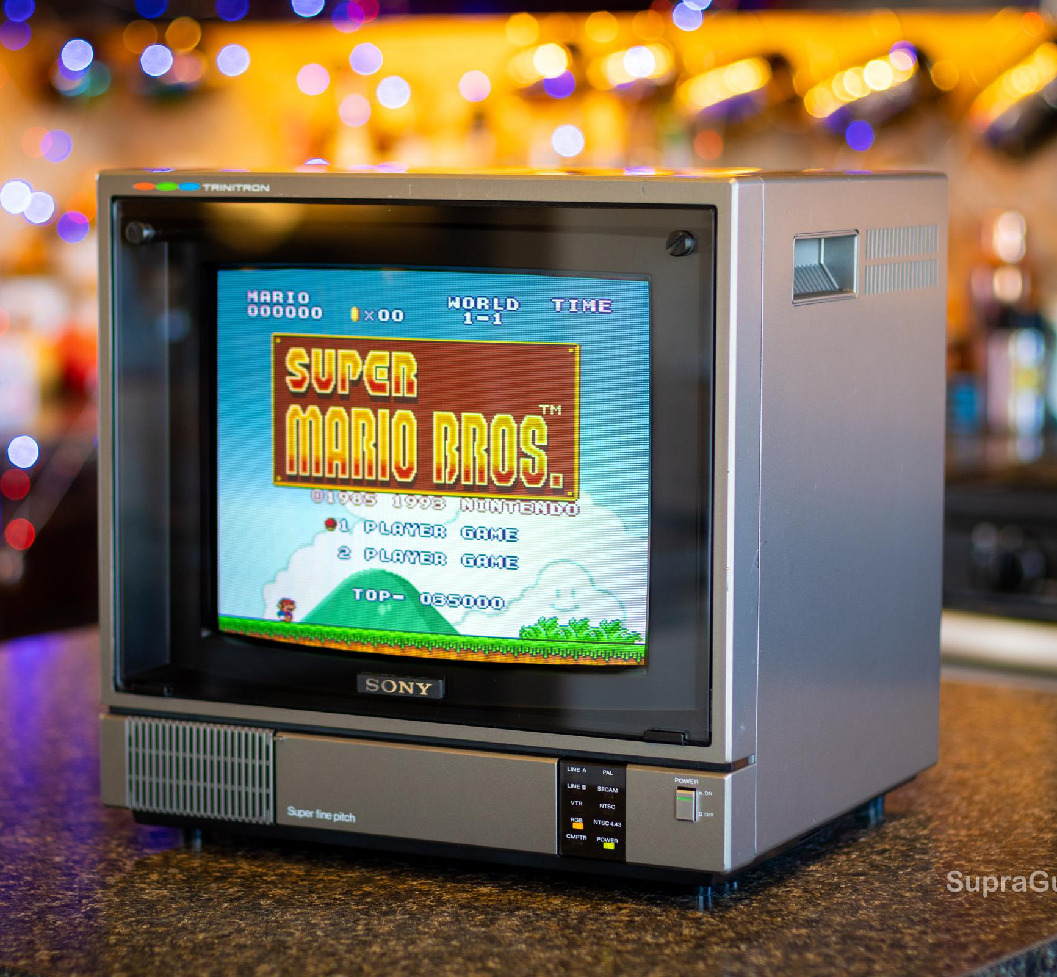
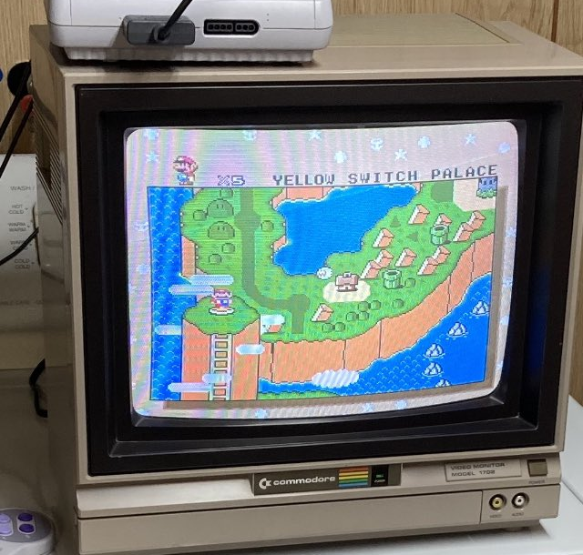
CRT Buyers Guide
Small
Close
Curved
SCART and AV option
Original remote!
Low noise
Degauss
No artifacts
Non-smoker

Slide 22
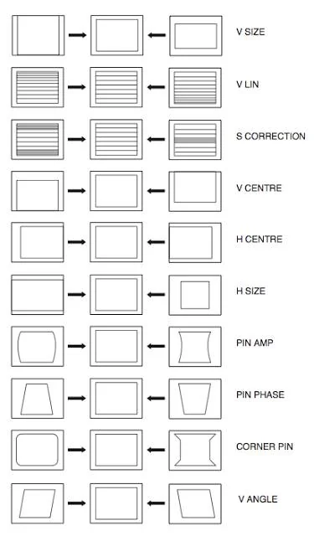
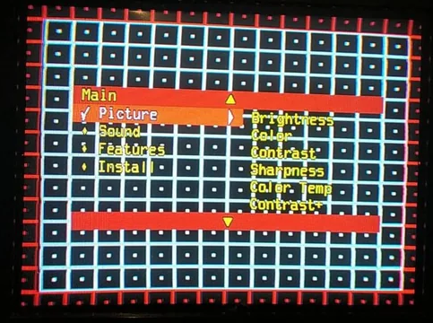
Service Mode

Slide 23
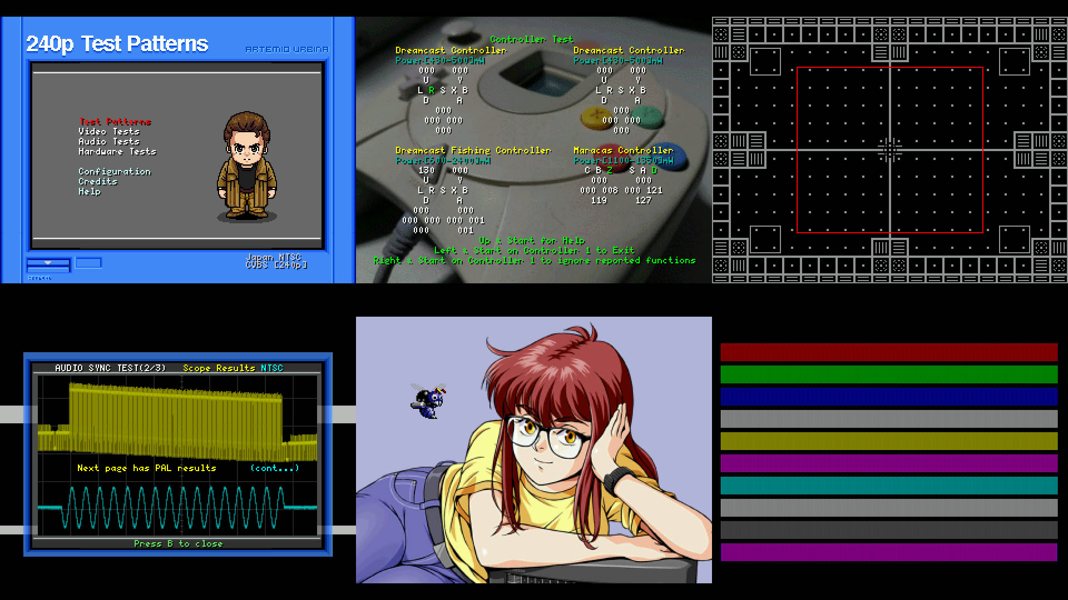
240p Test Suite

Slide 24
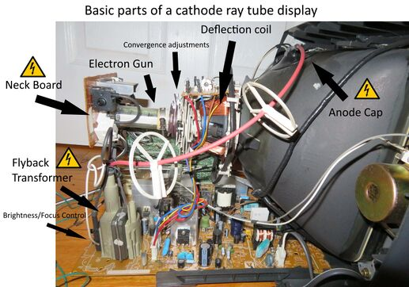

Slide 25
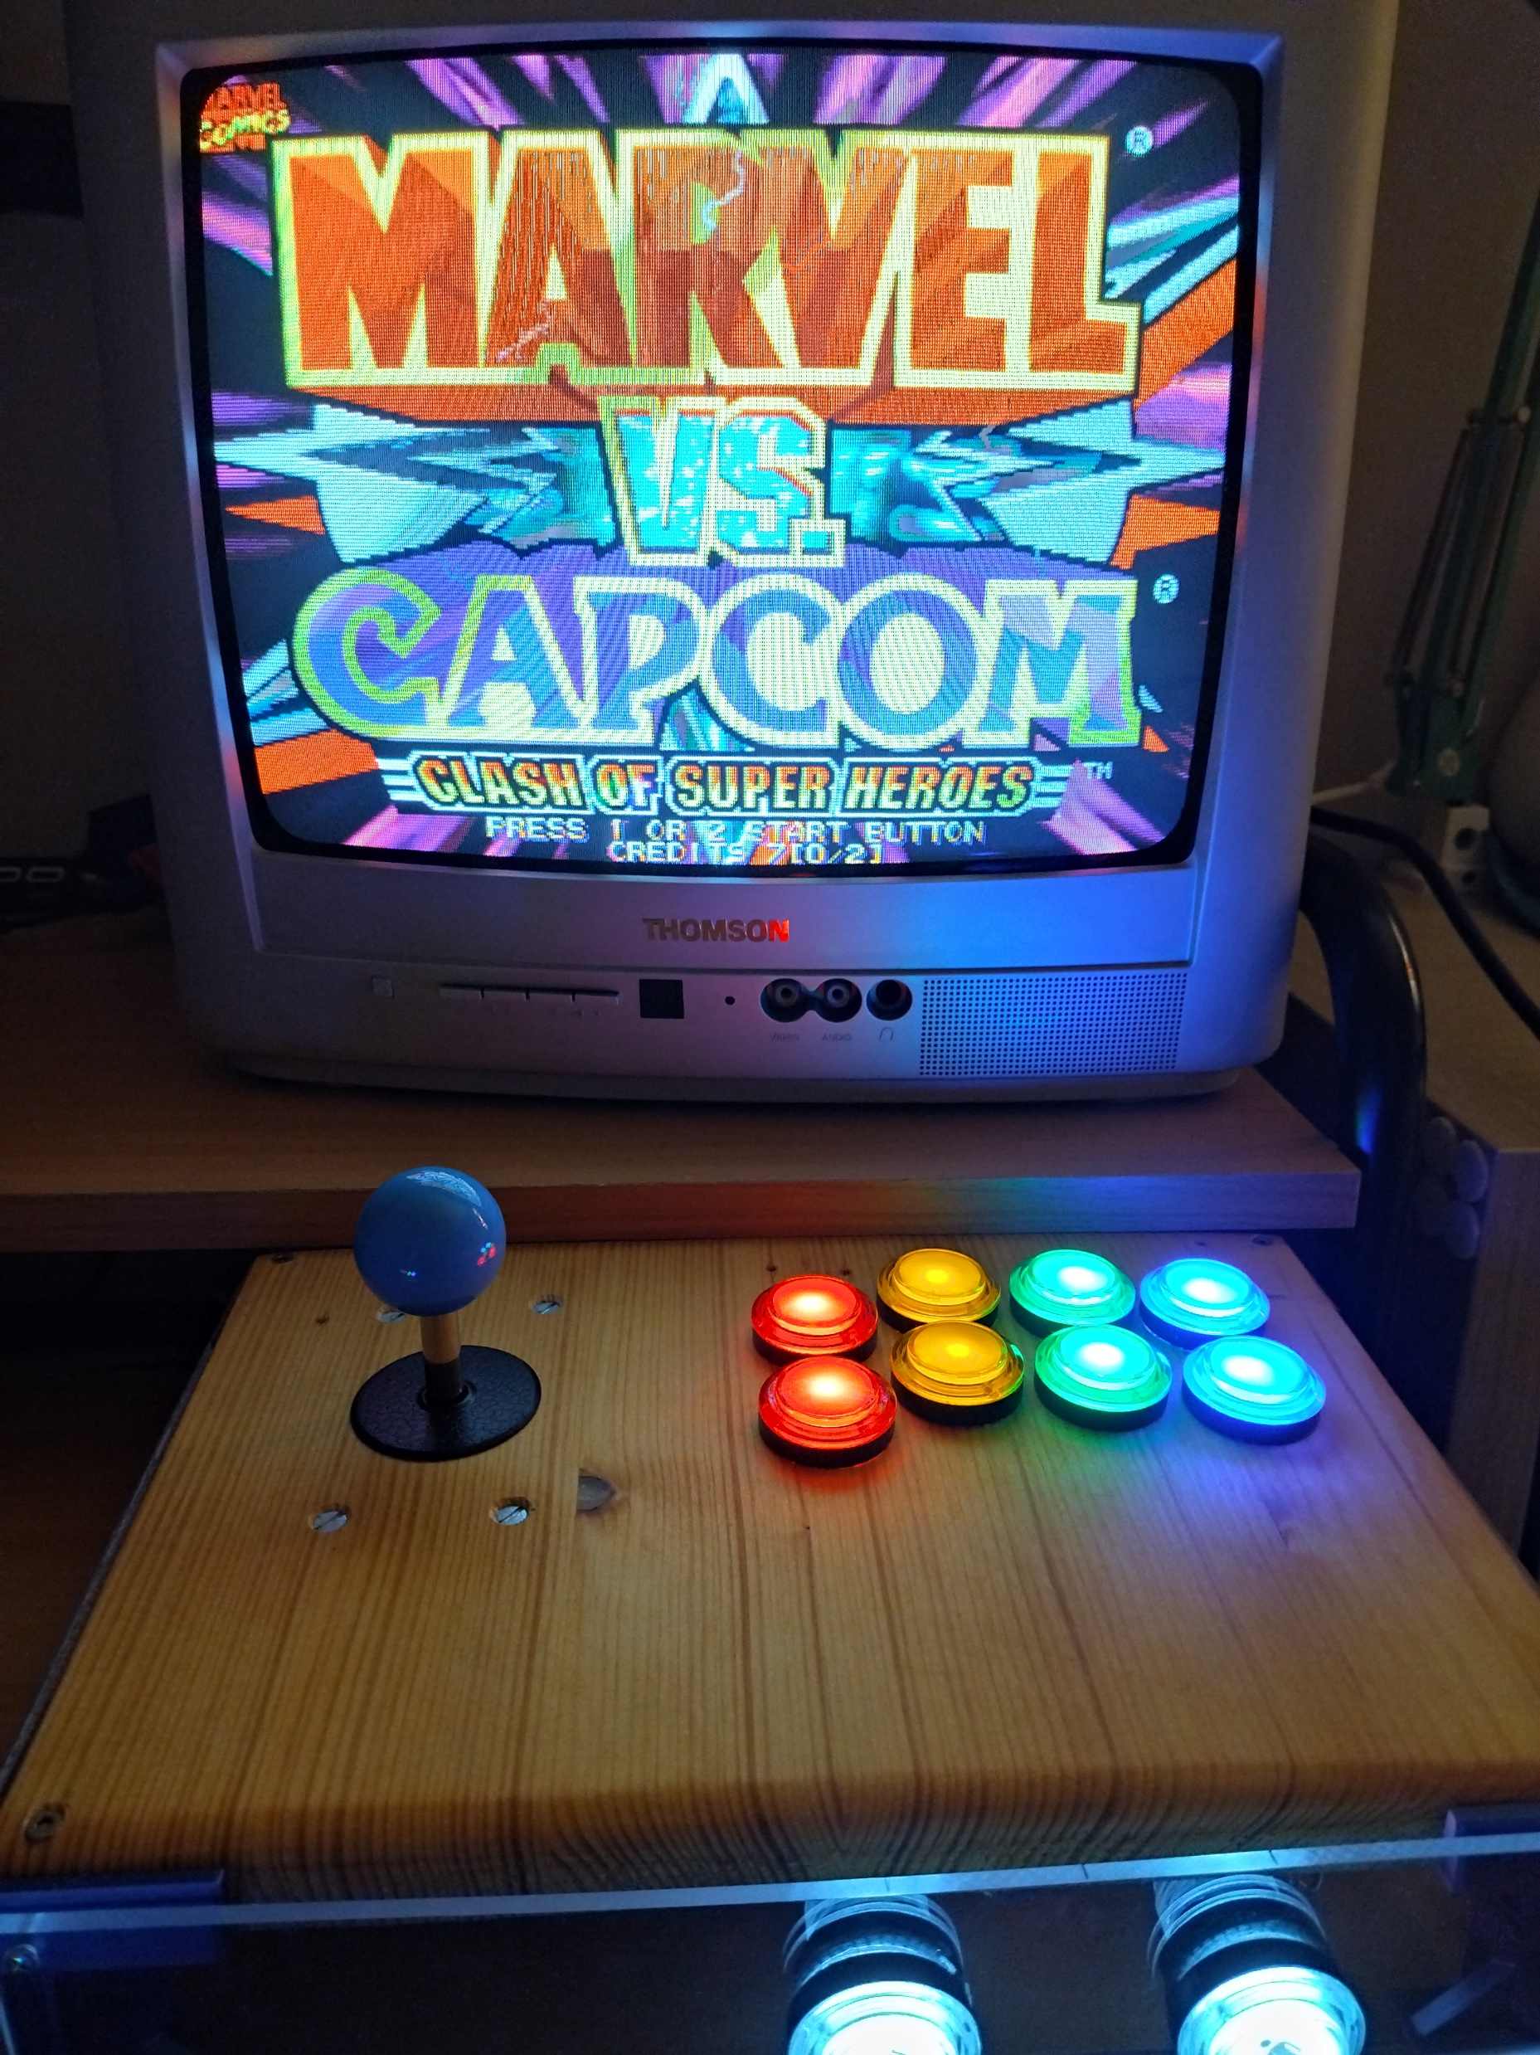
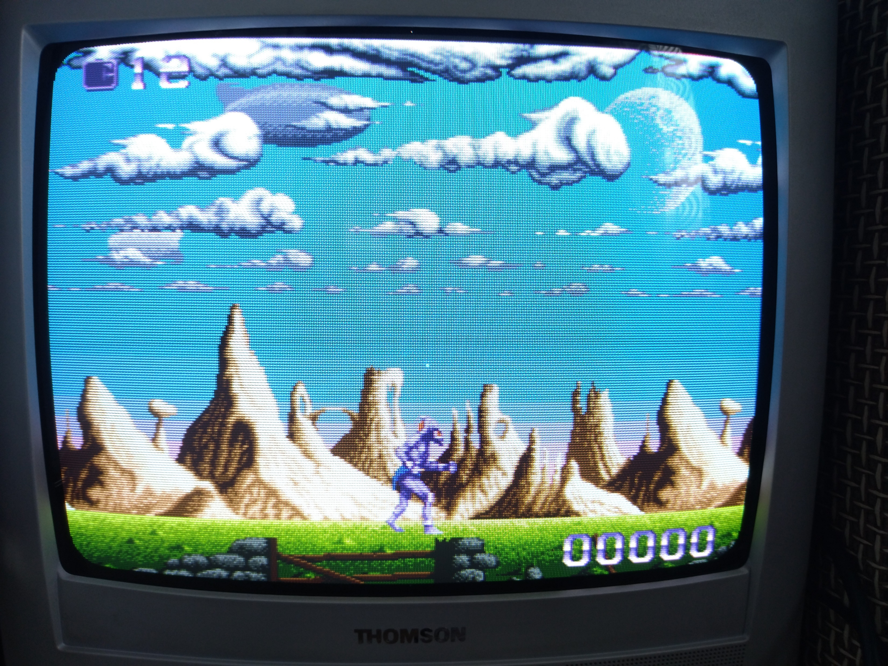
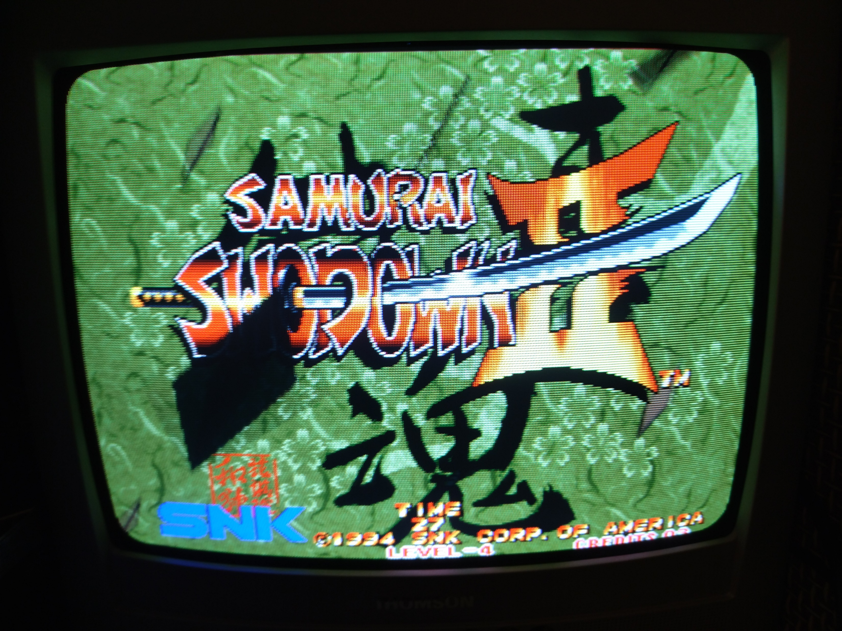
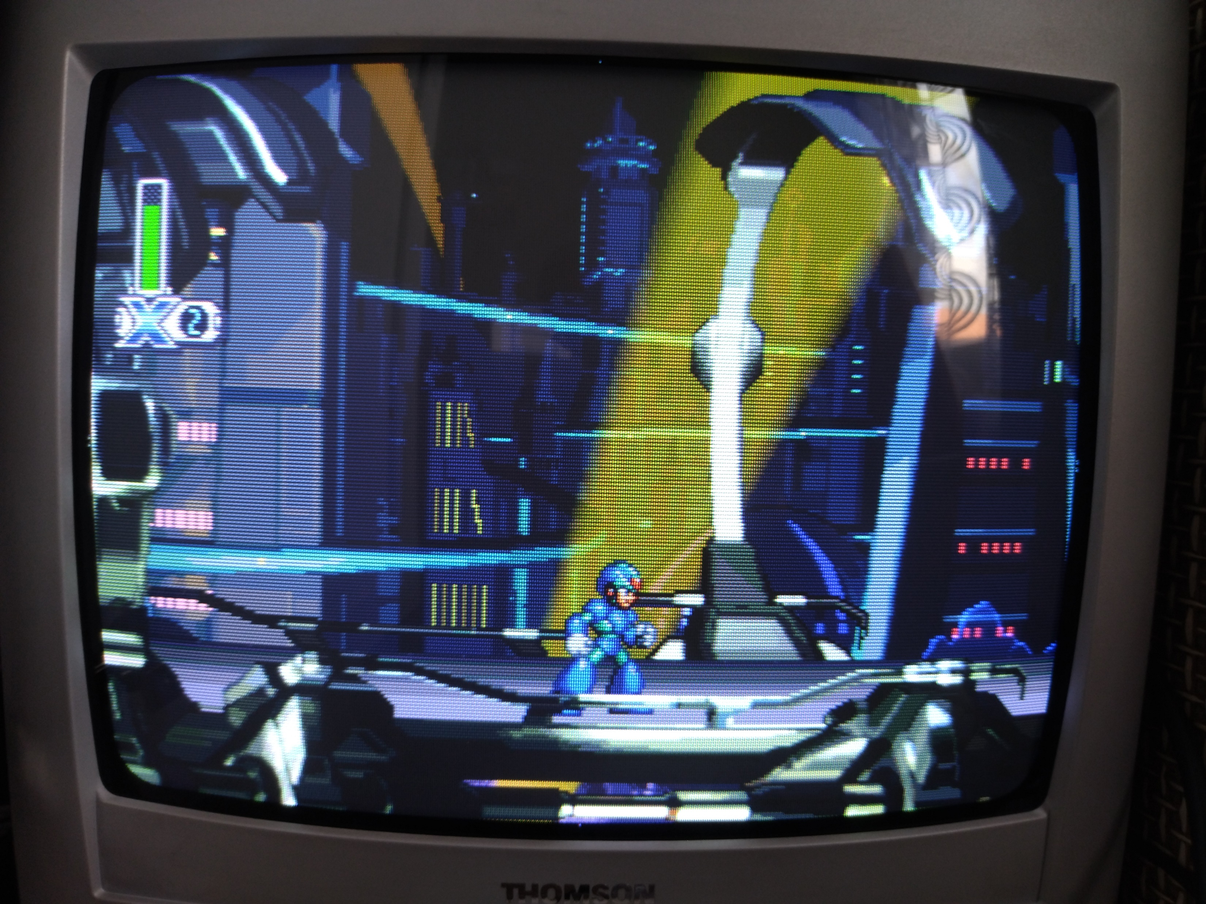
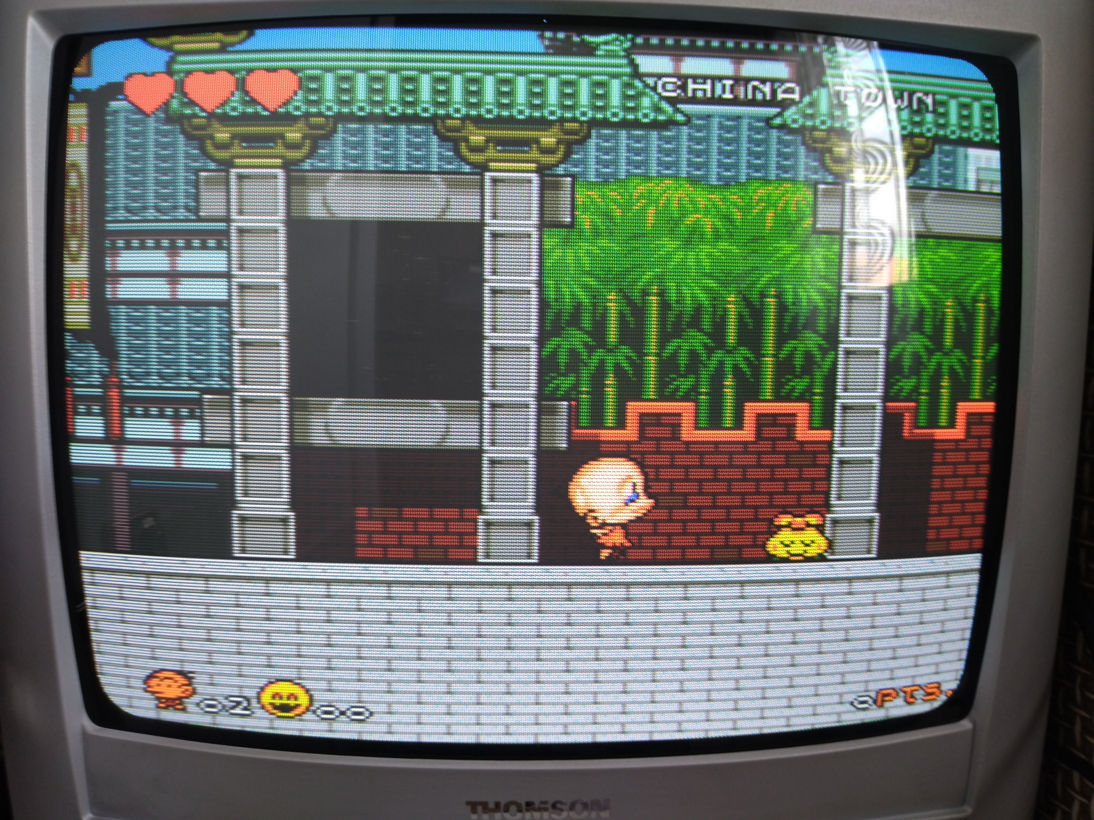
Happy Gaming!

Slide 26


Thanks!

Slide 27
References
VGA2SCART
https://www.reddit.com/r/crt/comments/vvqy7g/im_trying_to_make_a_small_vga_to_scart_converter/
https://hangdobozepites.hu/m/vga2scart/
RetroArch
https://www.libretro.com/index.php/retroarch-1-20-0-release/
VGA Adapters
https://vi.aliexpress.com/item/32728997597.html
https://www.hackster.io/news/add-scart-and-vga-to-your-raspberry-pi-for-crt-retro-gaming-5b75b882f240
https://www.osaelectronics.com/product/rgberry-scart/
https://github.com/llegoff/Pi400RGB

Slide 28
References
Arcade Stick
https://www.tinkercad.com/things/5elUwxONBnF-arcade-stick-plexi
https://www.slagcoin.com/joystick/layout.html
CRT
https://crtdatabase.com/
https://repair.wiki/w/CRT_General_Repairs
https://www.youtube.com/@RetroTechUSA
https://www.reddit.com/r/crtgaming/comments/7h50ta/crt_service_menu_cheat_sheet/
https://github.com/ArtemioUrbina/240pTestSuite

